Slide 1

Altruism

Slide 2

Why Do We Help?
https://www.youtube.com/watch?v=R6SqLXsBMBw

Slide 3
Prosocial Behaviour
Actions that are considered to be beneficial to others and have positive outcomes
Helping
Philanthropy
Altruism
Volunteering

Slide 4



Altruism
The belief that the well-being of others is equal to or greater than your own
Selfless acts that put the welfare of others before yourself
https://www.cnn.com/2018/02/20/us/ny-troopers-help-woman-get-to-fl-trnd/index.html

Slide 5
Friends Clip – ‘No Selfless Good Deed’
https://www.youtube.com/watch?v=DowJfUmlzeI

Slide 6
What Motivates Us to Help?
Social Exchange Theory
Altruism and Empathetic Concern
Evolutionary Perspectives

Slide 7

Social Exchange Theory
Combines Psychology, Sociology, and Economics to Understand Social Interactions and Helping Behaviour
Cost-Benefit Analysis
Egoism

Slide 8

Altruism and Empathetic Concern
People As Generous, Unselfish
Empathy Drives Our Need to Help

Slide 9
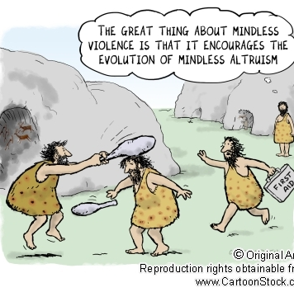
Evolutionary Perspectives
Prosocial Behaviour as Beneficial for Survival
Genetic Trait Passed Down from Generation to Generation

Slide 10
Characteristics of Those We Help
A Number of Factors
Know the person
Like the person
Similarity to us
Deserving of help

Slide 11

The Impact of Norms
Cultural Norms Dictate When it is Appropriate and Inappropriate to Help
Social Responsibility Norm
Norm of Reciprocity
Personal Norms

Slide 12


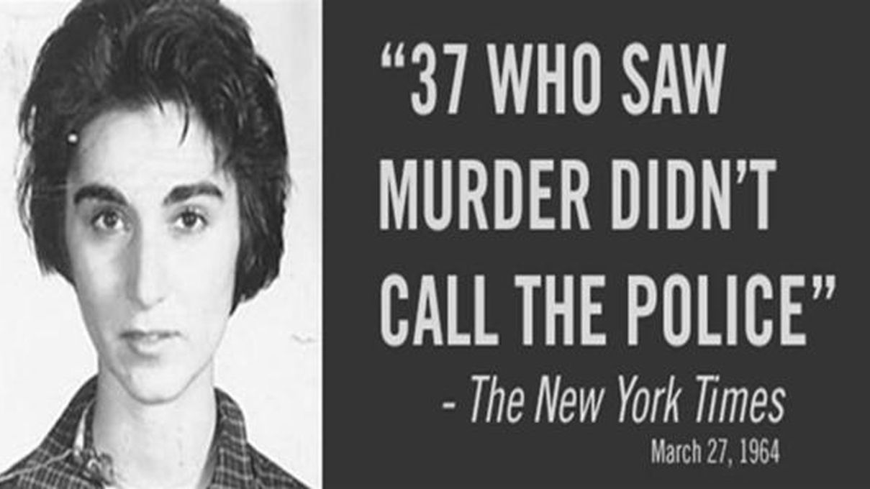
Bystander Intervention and Effect

Slide 13
Bystander Intervention
A Number of Factors Determine Whether We Intervene:
Notice the situation
Interpreted as an emergency
Feeling of personal responsibility
Belief that we can provide help
The decision to act

Slide 14
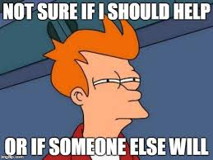
Bystander Effect
The More People in the Crowd, The Less Likely One is to Help
Ambiguity of the Situation
What Others Will Think
Diffusion of Responsibility

Slide 15
The Bystander Effect Revisited
“The Bystander Effect is Complicated – Here’s Why”
https://www.youtube.com/watch?v=Ufs8cKyzLvg

Slide 16
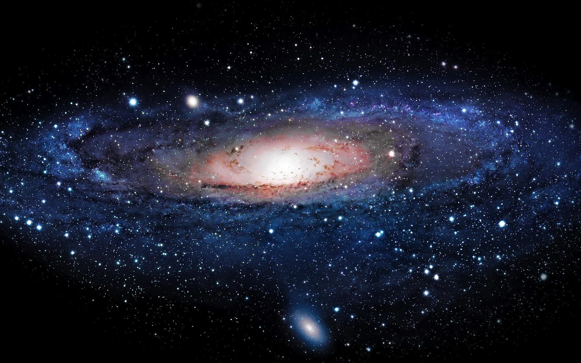

Have a Great Day!

